Slide 1
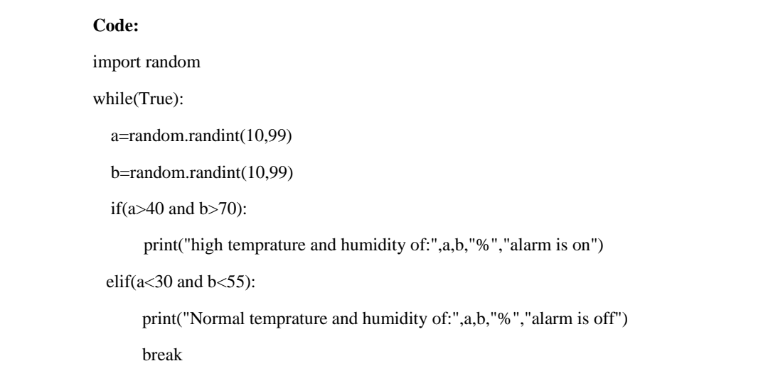
ASSIGNMENT NO -2
Project Name : INDUSTRY SPECIFIC SAFETY INTELLIGENT FIIRE MANAGEMENT SYSTEM
Batch Number: :
Assignment Topic : Assignment on temperature and humidity sensing and alarm automation using python
TEAM MEMBERS
Team lead : M..Rishalin Member-1 : R.Rajasushmitha Member -3 :T.Ramya Member-4 : S.Sajithachandran

Slide 2
